Slide 1
Math Kangaroo at SDMC

Slide 2
Math Kangaroo is a locally-administered international math competition.
Math Kangaroo originates from Australia, which provides the cultural context for the name of the competition.
Math Kangaroo in the United States is administered by Math Kangaroo USA, a non-profit entity.
SDMC offers Math Kangaroo as a community service for students of the San Diego community. SDMC does not create the content for the exam, nor do we grade the exams or have any control over the policies, practices or rules involved. We do not receive any form of compensation for the service we provide.

Slide 3
Who participates?
SDMC officiates Math Kangaroo in San Diego for several groups of students:
“Regular” SDMC students – you are a regular SDMC student if you are currently registered and possess a current, valid regular SDMC Student ID Code.
“At large” SDMC students – you are an at-large SDMC student if you are so registered for the current year and possess an at-large SDMC Student ID Code.
The general public – if you do not fall in one of the above categories, you are part of the general public.
SDMC offers Math Kangaroo to ALL of the above categories, but in the priority order
Regular > At Large > General Public.

Slide 4
Priority
Priority is assigned as follows:
Until November 15, Math Kangaroo registration is limited to Regular and At Large students.
From November 15 – December 15 (or earlier if forced to close), registration is open to the general public. (SDMC students may continue to register, but may miss out if we are forced to close registration early.)
Registration is closed to all students after December 15.
If at any time capacity constraints force us to close registration, priority will be assigned according to
Regular > At Large > General Public.

Slide 5
Grade Levels
The content of Math Kangaroo is stratified by grade level from the first grade through the twelfth.
Your Math Kangaroo level will be determined according to the information you provide at registration.

Slide 6
Sign up as usual and send a check?
No!
The usual SDMC event sign up method does not apply here.
Math Kangaroo has its own online registration tool, and takes payments through this online tool.
SDMC is not involved at all in the processing of your registration and/or payments.
You must go the Math Kangaroo website and follow their procedure.

Slide 7
Where and When?
The specific location of SDMC’s exam session(s) will be determined after some clarity develops on our registration totals at or near the end of December.
The location will be posted on our SDMC Math Kangaroo event page in early January and will most likely be on the UCSD campus.
Similarly, the exact time for each session will depend on our space reservation, but will most likely be in the early evening, typically around 6:30pm; this too will be posted to our event page in early January.

Slide 8
Registration

Slide 9
Read registration instructions and FAQ

Slide 10
Create an account.
This is not the same thing as registration for the upcoming exam.

Slide 12
There is nothing particularly tricky on this page. Just provide all the information requested and make notes of the entries you make for the various security items, for future reference as you need them.

Slide 13
After creating an account, enter the User Login area here.
This is where you will actually register for the competition.

Slide 15
There’s a lot going on on this page.
As a new student, ignore all of it except the “New Student Registration” link; click that and go.

Slide 17
Select location first.
This is where you will select SDMC as the center where you will take your exam.

Slide 19
Select the appropriate entries (as illustrated above) from each of the drop down menus.
When registration opens to the general public, the restrictive text “Only for Students of” will be removed.

Slide 21
Verify that you have selected SDMC as your test center. To transfer to a different center at a later date, just click “change location” and revise your selections.
SDMC does not receive most of this info. We rely on the adult email and telephone, so please be sure these are correct.

Slide 23
You’ve been here already, but now your student appears in the “My Students” pane and you are prompted to pay. Don’t tarry; unpaid registrations expire in about 24-48 hrs.

Slide 25
Pay and you’re done!

Slide 26
What does your fee pay for?
In addition to the services provided in administering the competition, each student receives
a t-shirt,
a certificate of participation,
a gift
a competition booklet and
a pencil
medals or ribbons for high scorers

Slide 27
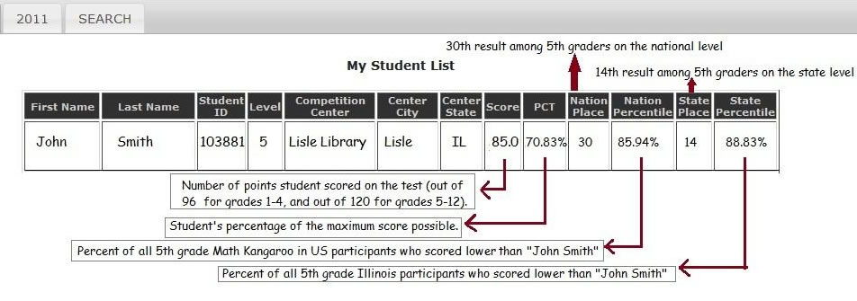
How do I get my score?
A top bracket of students have their results openly posted on the Math Kangaroo website under the “results” sidebar tab.
All students may log in to their user account to view their score, including some statistical information.
Please see the Math Kangaroo website for related details.

Slide 28
Where to go for more information?
For registration and information about the contest, go to
www.mathkangaroo.org
Inquiries: info@mathkangaroo.org
For local information about SDMC’s exam session, including the location, time, and directions, go to
http://www.sdmathcircle.org/index.php?page=math-kangaroo
Inquiries: sdmcsignups@sdmathcircle.org

